Slide 1
Invertebrate development

Slide 2
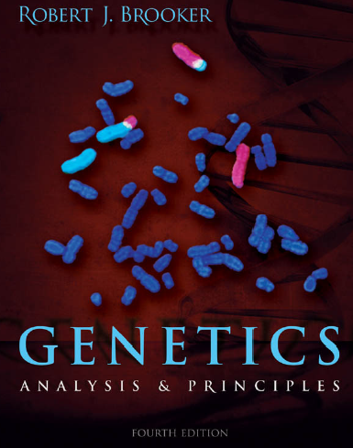
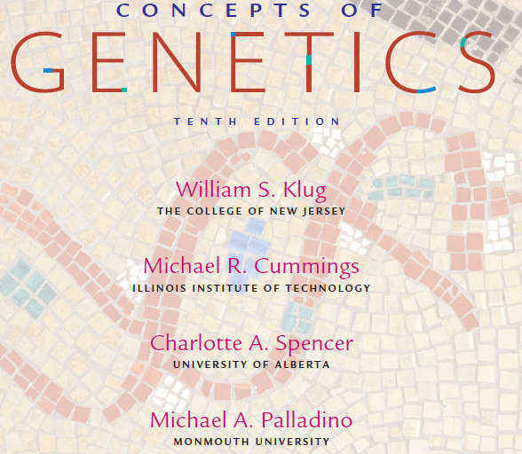
Books
Developmental Genetics chapter in any standard Genetics book

Slide 3
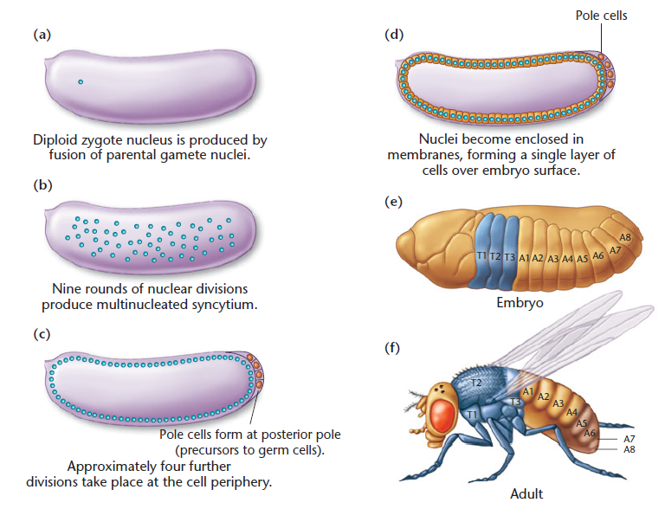
Early stages of embryonic development in Drosophila

Slide 4
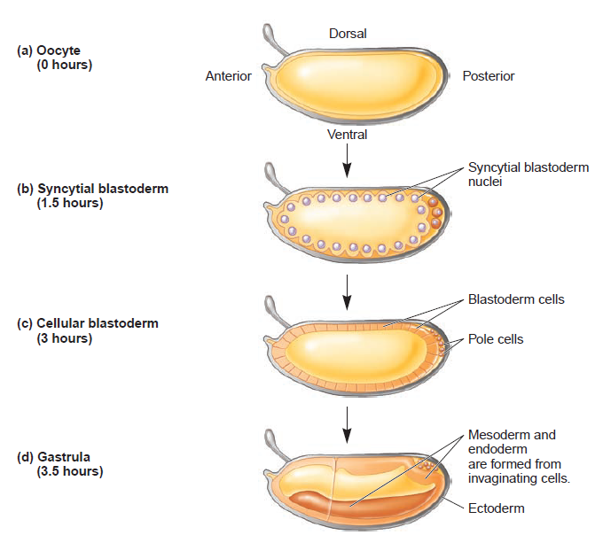
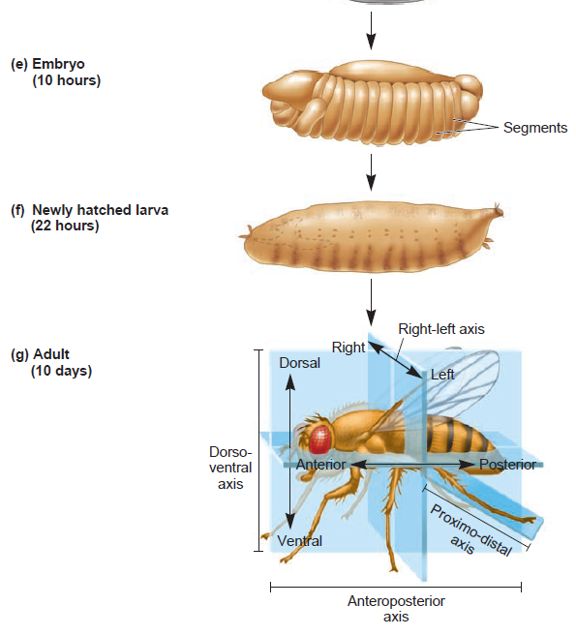
Developmental stages of Drosophila

Slide 5
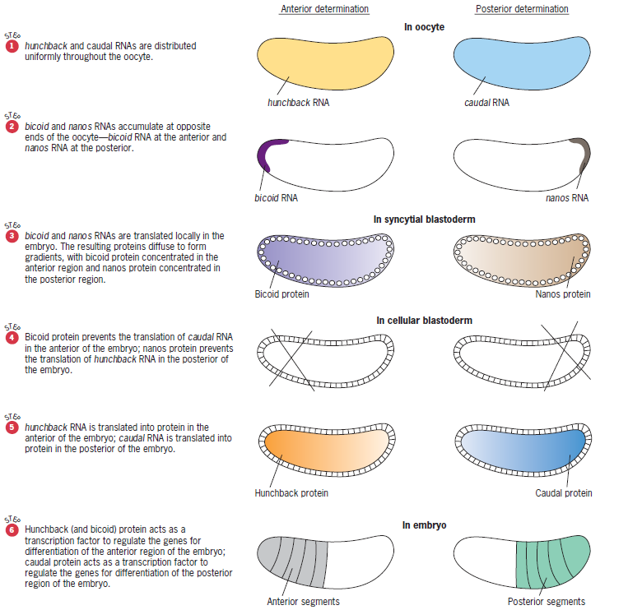
Determination of the anterior-posterior axis in Drosophila by maternally supplied RNAs

Slide 6
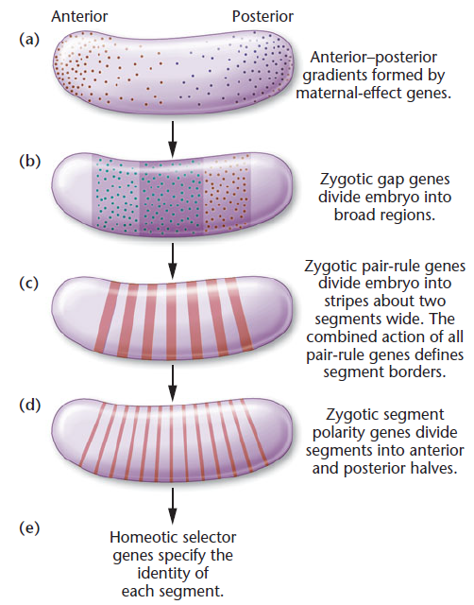
Cascade of gene expression to produce segmentation in Drosophila embryo

Slide 7
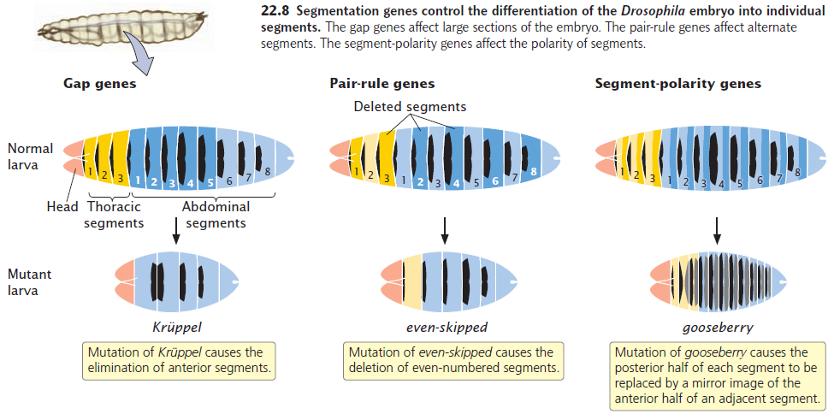
Segmentation genes

Slide 8
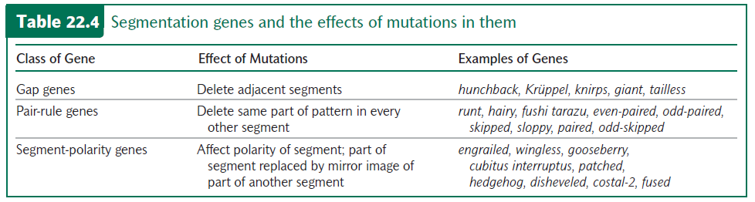

Slide 9
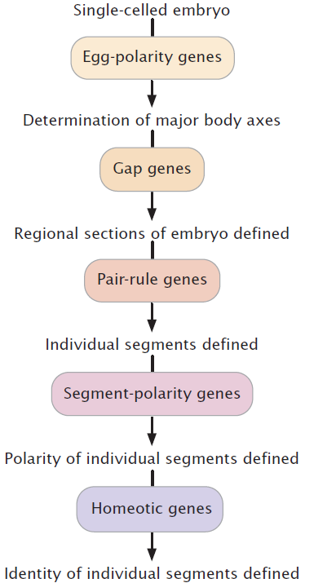
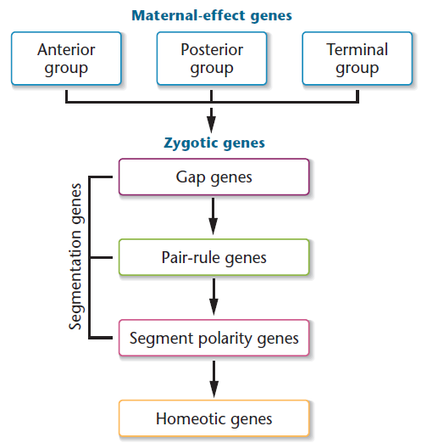
A cascade of gene regulation establishes the polarity and identity of individual segments of Drosophila

Slide 10
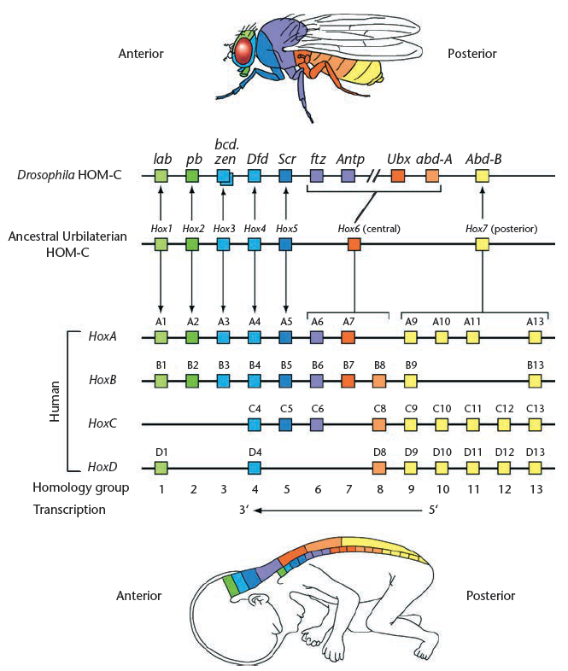
Conservation of homeotic genes

Slide 11
Plant development

Slide 12
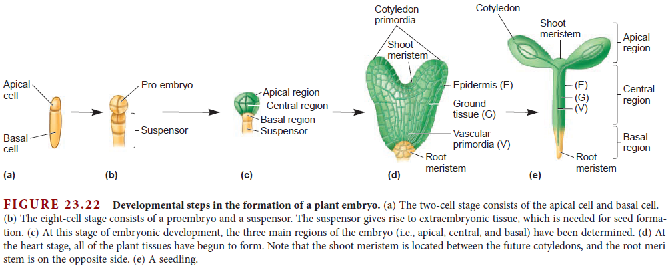
Developmental steps in the formation of a plant embryo

Slide 13
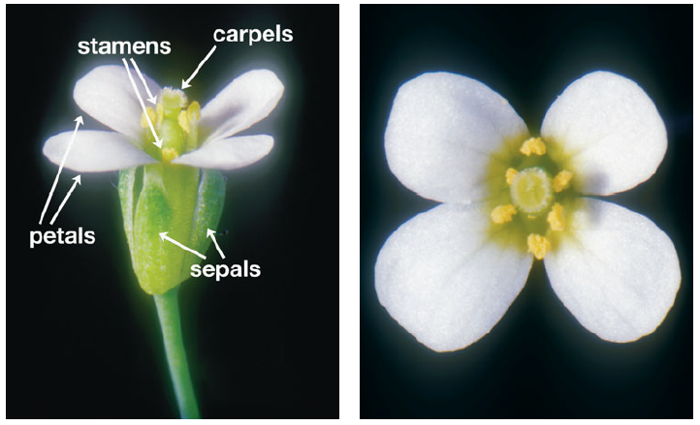
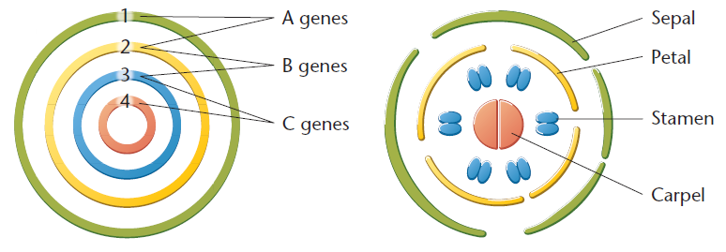
Development of the parts of the Arabidopsis flower

Slide 14
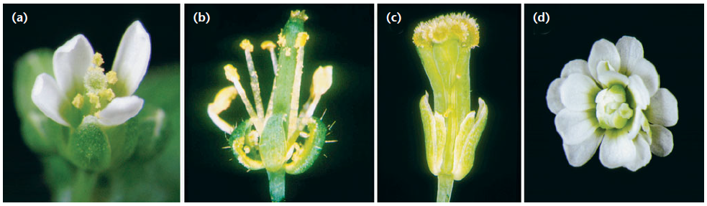
Development of the parts of the Arabidopsis flower
WT
Class A mutant
Class B mutant
Class C mutant
Class A mutant has carpels, stamens, stamens, and carpels.
Class B mutants have sepals, sepals, carpels, and carpels.
Class C mutants have petals and sepals
at places where stamens and carpels should form.

Slide 15
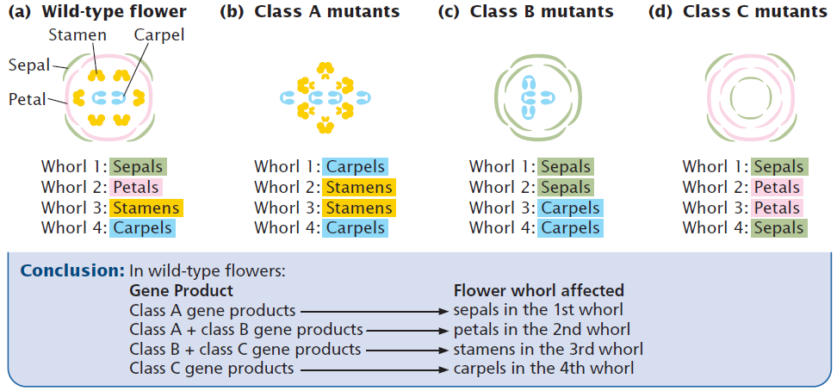
Plant homeotic genes control flower development

Slide 16
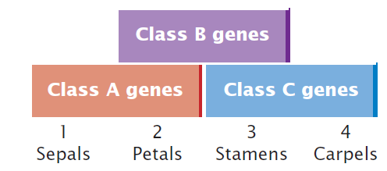
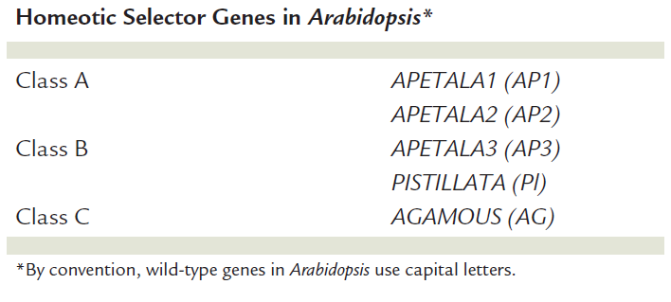
The ABC model of Arabidopsis flower development

